Slide 1
Daniel and Daniel
Quote on 220 guests
Appetizers
Dinner
Dessert
For now, one free drink (+juices, water)
Cost: $27,284.31

Slide 3
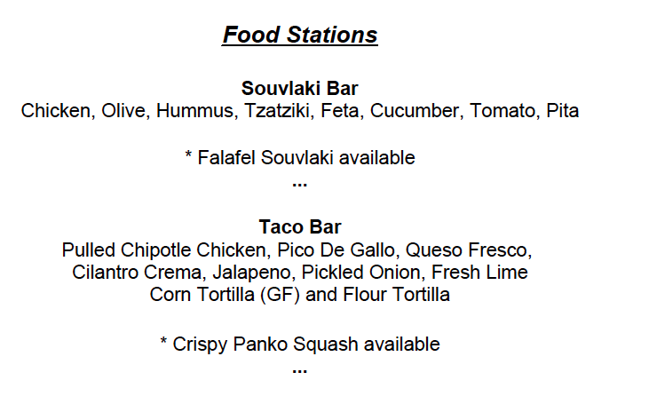

Slide 4
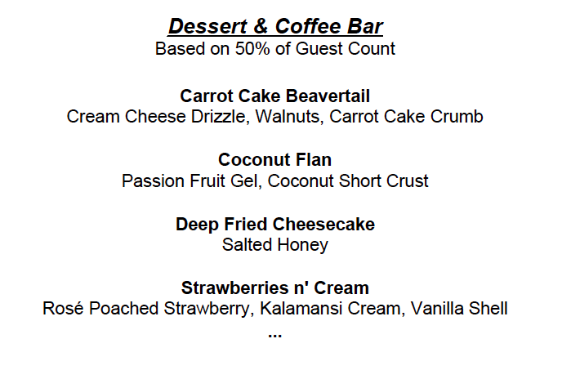

Slide 5
